Slide 1

Plant Disease Prediction System
Asad Khan FA21-BSE-081
Furqan Ahmad FA21-BSE-089
Abdul Muhaimin FA21-BSE-061
Supervisor : Sir Javed Raza
Department of Computer Science
COMSATS University Islamabad, Abbottabad Campus

Slide 2
Agenda of the Presentation
Motivation
Introduction
Scope
Functionalities
Tools and Platform
Feasibility (Technical, Financial, Resource, Operational)
Schedule (Gantt Chart)
First Iteration Goals
Conclusion

Slide 3
Motivation
Utilitarian aspects:
Early Detection of plant disease for formers.
Motivation:
Support agricultural productivity using advanced technology.

Slide 4
Brief Introduction
Overview of the Plant Disease Prediction System.
Utilizes image recognition and machine learning for accurate diagnosis.
Provides treatment recommendations and preventive measures.

Slide 5
Scope
Inclusions:
Disease Prediction: Analyze images uploaded by users to predict diseases in plants.
Real-Time Recommendations: Provide instant suggestions based on diagnosed diseases.
Weather Data Integration: Factor environmental conditions for more accurate predictions.
Multilingual Support: Ensure accessibility for farmers from different linguistic backgrounds.
Exclusions:
Prediction Limitations: System limited to diseases it has been trained on.
Image Quality Requirements: Accurate predictions require high-quality images.

Slide 6
Functionalities
User Authentication: Secure login system for users.
Disease Prediction via Image Upload: Use machine learning to analyze plant images and predict diseases.
Plant Health Monitoring: Track plant health over time with regular checkups.
Disease Information & Recommendations: Provide actionable information on diagnosed diseases.
Weather and Environmental Integration: Combine local weather data to enhance prediction accuracy.
Notifications & Alerts: Alert users to disease risks or reminders for monitoring.

Slide 7
Proposed Tools/Platform
Tools:
Visual Studio,
SQL Server,
MS Word,
MS PowerPoint
Pencil
Technologies:
JavaScript (React)
CSS,
Node.js/Django

Slide 8
Feasibility
Technical Feasibility
Machine Learning Integration: Leverages a trained model for plant disease detection, using image processing to accurately diagnose diseases.
Image Processing Capabilities: Processes uploaded images for high-accuracy disease detection.
Weather Data Integration: Enhances the prediction model by integrating weather data to account for environmental conditions.

Slide 9
Feasibility
Financial Feasibility
Budget Considerations: Cost of software licensing, cloud infrastructure, and maintenance.
Funding Opportunities: Explore funding from agricultural and technology grants to offset costs.
Long-term Costs: Maintenance and updates to model datasets for emerging plant diseases.

Slide 10
Feasibility
Resource Feasibility
Hardware and Software Resources: Access to robust servers and cloud storage for model training and image processing.
Data Sources: Requires comprehensive agricultural datasets and machine learning libraries.
Technical Expertise: Team members with skills in machine learning, data processing, and agricultural science are essential

Slide 11
Feasibility
Operational Feasibility
Farmer Suitability: Designed for accessibility by non-technical users, especially farmers.
Scalability: Capable of scaling to accommodate larger datasets and additional users as needed.
Ease of Use: A streamlined user experience to ensure ease of adoption by farmers and agronomists alike.

Slide 12
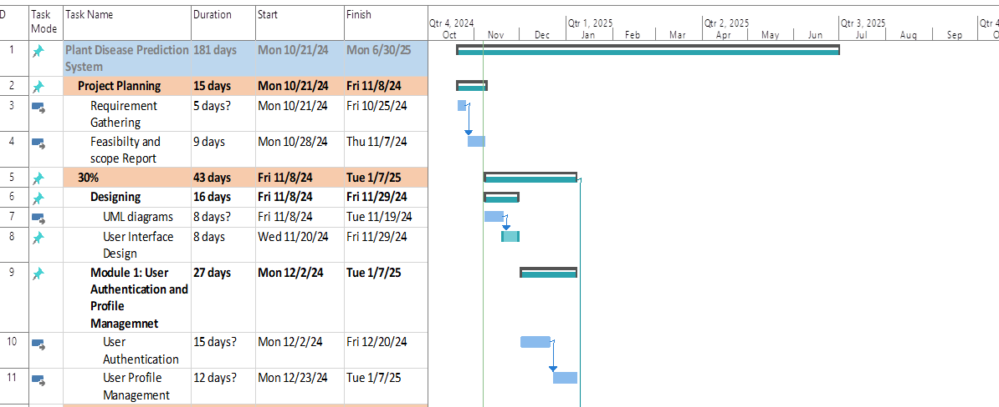
Gantt Chart

Slide 13
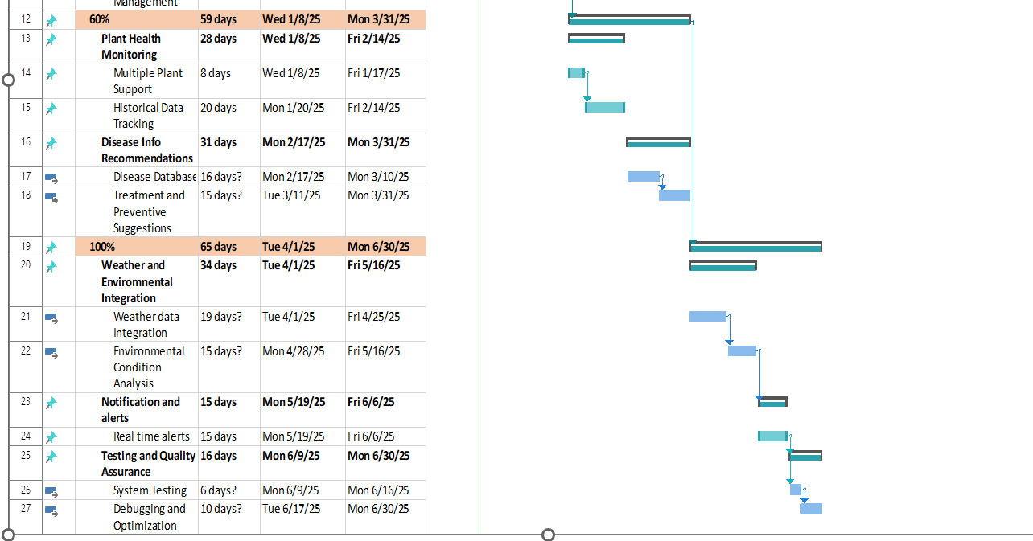
Gantt chart Cont..

Slide 14
Tasks for 1st iteration.. (30%)
Design Use-Case Diagram , Detailed Use-cases.
Design Class Diagram, Sequence Diagrams.
Design ER Diagram, DFD diagrams (0,1,2)
User interface designs
User authentication and profile management.

Slide 15
Conclusion
The Plant Diagnose System presents a viable, accessible, and impactful solution to assist farmers in monitoring plant health and predicting diseases early. By integrating image processing and machine learning with agricultural expertise, this system has the potential to enhance agricultural productivity and sustainability. With a clear technical roadmap, secured resources, and financial feasibility considerations, this project is well-positioned for successful development and implementation.

